Slide 1
Ricci & Karen in Transition
2016 onwards
Listen to advice and accept instruction, and in the end you will be wise.
Many are the plans in a man’s heart, but it is the LORD'S purpose that prevails.
^{Proverbs 19:20-21}

Slide 2
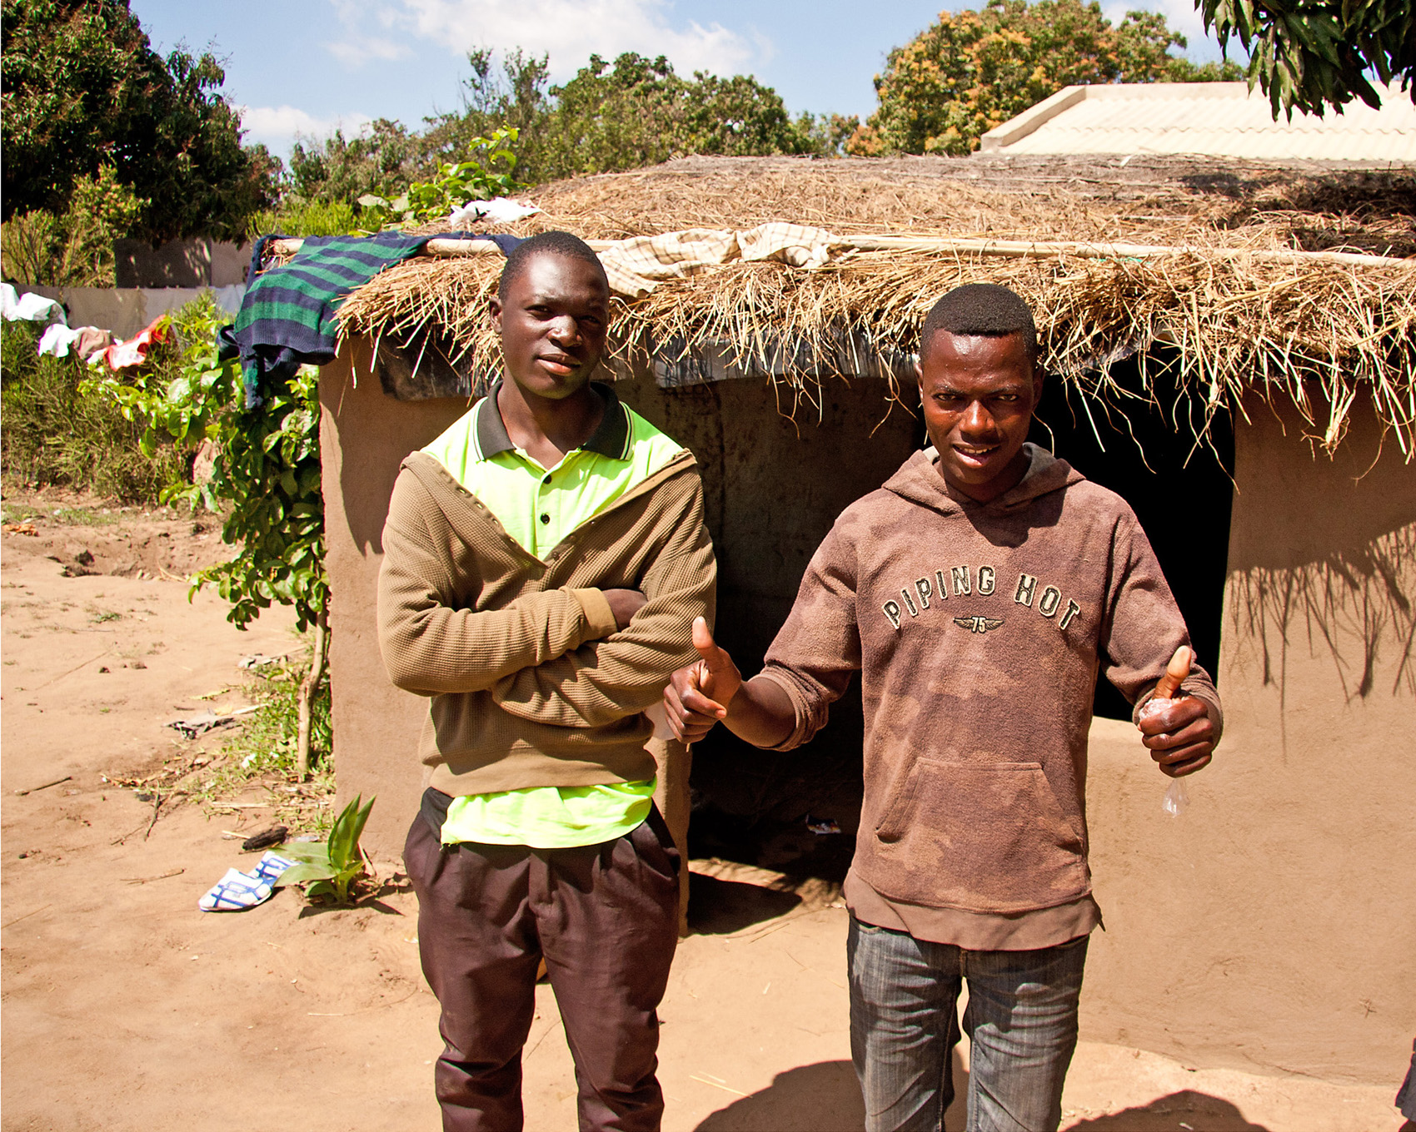
In our Generation we can Eradicate Extreme Poverty & Unfair Trade

Slide 3
Poverty
If it is true that we can end poverty in our generation, then we have a duty as Christians to try.
Various things have inspired us to think that it might be possible in this generation to end poverty. The inspirations have been the Jubilee 2000 and Make Poverty History campaigns, the Live58 film based on the true fast in Isaiah 58 and Jeffery Sachs’ book “The End of Poverty”.

Slide 4
Isaiah 58:1-7
"Shout it aloud, do not hold back. Raise your voice like a trumpet. Declare to my people their rebellion and to the house of Jacob their sins. For day after day they seek me out; they seem eager to know my ways, as if they were a nation that does what is right and has not forsaken the commands of its God. They ask me for just decisions and seem eager for God to come near them. 'Why have we fasted,' they say, 'and you have not seen it? Why have we humbled ourselves, and you have not noticed?'
"Yet on the day of your fasting, you do as you please and exploit all your workers. Your fasting ends in quarrelling and strife, and in striking each other with wicked fists. You cannot fast as you do today and expect your voice to be heard on high. Is this the kind of fast I have chosen, only a day for a man to humble himself? Is it only for bowing one's head like a reed and for lying on sackcloth and ashes? Is that what you call a fast, a day acceptable to the LORD?
"Is not this the kind of fasting I have chosen: to loose the chains of injustice and untie the cords of the yoke, to set the oppressed free and break every yoke? Is it not to share your food with the hungry and to provide the poor wanderer with shelter-when you see the naked, to clothe him, and not to turn away from your own flesh and blood?
Question: What does God dislike and how would He improve it?

Slide 5
Chimoio, Mozambique
Tearfund partner, Kubatsirana, is helping children orphaned by HIV/AIDS
The 2 boys, who were pictured on an earlier slide, were outside their house where they live with their 3 younger sisters, who they have looked after since their parents died of AIDS. The house is tiny. Thatch roofs like this leak if not regularly repaired. The only help they receive is from volunteers. A better healthcare system could have kept their parents well for longer, but Mozambique can’t afford that.

Slide 6
Yellow potatoes
Key Kubatsirana projects are income generation and better nutrition for people affected by HIV
Good nutrition is particularly important for people who have HIV. But illness increases poverty and reduces people’s ability to get enough to eat. Insufficient food stunts children’s growth both physically and intellectually, meaning they are less able to break free from poverty. There is enough food in the world to break this cycle.
Breaking it is not a matter of charity but of justice.

Slide 7
James 5:1-6
Now listen, you rich people, weep and wail because of the misery that is coming upon you. Your wealth has rotted, and moths have eaten your clothes. Your gold and silver are corroded. Their corrosion will testify against you and eat your flesh like fire. You have hoarded wealth in the last days. Look! The wages you failed to pay the workmen who mowed your fields are crying out against you. The cries of the harvesters have reached the ears of the Lord Almighty. You have lived on earth in luxury and self-indulgence. You have fattened yourselves in the day of slaughter. You have condemned and murdered innocent men, who were not opposing you.
Question: Who are the workmen whose wages we are failing to pay?

Slide 8
Fair trade
Minka producers in Peru are able to earn 3 times as much by knitting for a fair trade organisation.
Now the clothes & soft toys are sold round the world, & the villagers earn money much more quickly. They have started a medical kitty, as well as funding the construction of the community centre you see in the picture.

Slide 9
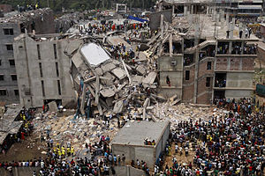
Unfair Trade
I do not think we can eradicate extreme poverty without eradicating unfair trade.
James wrote about a ‘day of slaughter’ … ‘you have condemned and murdered innocent men”’.
Do you think that’s true?
On 24 April 2013, the Rana Plaza clothing factory in Dhaka, Bangladesh, collapsed. Leading to the deaths of 1,133 garment workers and injuring many more.
Fair Trade is not a matter of charity, but of justice.

Slide 10
Luke 4:16-21
He went to Nazareth, where he had been brought up, and on the Sabbath day he went into the synagogue, as was his custom. And he stood up to read. The scroll of the prophet Isaiah was handed to him. Unrolling it, he found the place where it is written:
The Spirit of the Lord is on me, because he has anointed me to preach good news to the poor. He has sent me to proclaim freedom for the prisoners and recovery of sight for the blind, to release the oppressed,
to proclaim the year of the Lord's favour."
Then he rolled up the scroll, gave it back to the attendant and sat down. The eyes of everyone in the synagogue were fastened on him, and he began by saying to them, "Today this scripture is fulfilled in your hearing."
Question: How should we continue Jesus’s mission?

Slide 11
What We Might Do
Here’s a list of what we’ve thought of so far:
A degree: Politics, philosophy & economics: assuming brain or & funds will be up to that.
Go visit :
David Golding: TF Campaingn Warhorse.
Mark Stevenson who wrote an optimist’s tour of the future.
Brian Fikkert (When Helping Hurts).
Paul Collier (Bottom Billion).
Knowledgeable friends: Pip; Slarti; Andy Maclean.
Also investigate:
Learning to blog, web development, twitter.
How to run a campaign.
Coursira (education sources).
Visit some of the amazing art works or urban outreach etc that appear in Big Issue.
Generally look for inspiring people or projects that really make a difference.
Live abroad for 1-2 years, teaching English in India or astronomy in Peru.
Medium Long term possibilities:
Work within Unite or union movement generally.
Take to the streets / media as a campaigner:
I fancy walking, with my sat-nav; and my message; from one end of the country to another.
Find a charity which matches our vision, & work for them.
Guerilla – djembes | coordinate local activists.
Go into politics: e.g.
Start by lobbying MP & MEP’s for an end to extreme poverty
Ask them really, how would it be done and how we could help

